Slide 1
Machine Learning
M.Hamza Rizwan
2023-BS-AI-005
Presented to Mr. Saeed

Slide 2
Project Introduction
Overview
Emotion classification involves analyzing text data to determine the underlying emotion expressed in a sentence. This is an important task in natural language processing (NLP), as it helps machines understand human emotions from language.
Motivation
The purpose of this project is to create an emotion classifier capable of detecting emotions such as joy, sadness, anger, fear, love, and surprise from text. Emotion-aware systems can be used in mental health monitoring, sentiment analysis, social media moderation, and empathic chatbots, enhancing how machines interact with users.

Slide 3
Dataset Description
Source and Structure
The dataset consists of short English sentences labeled with one of six emotion categories. Each data point is structured as a sentence followed by an emotion label, separated by a semicolon. For example: "I'm feeling rather rotten so I'm not very ambitious right now; sadness.“
Data Split
To ensure model generalization and proper evaluation, the dataset was divided into three parts:
Training set
Validation set
Test set

Slide 4
Dataset Description
Emotion Categories
The emotions covered in the dataset include:
Joy
Sadness
Anger
Fear
Love
Surprise

Slide 5
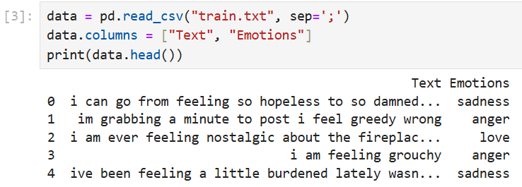
Dataset Description
This function/ block shows that the dataset i.e train.txt is being read

Slide 6
Preprocessing steps
Text Cleaning
All text was converted to lowercase, and punctuation marks were removed to normalize the data.
Tokenization
Each sentence was broken down into individual words or tokens for easier processing by the model.
Stopword Removal
Common words like “is,” “the,” and “a” were removed, as they don’t contribute significantly to emotional context.

Slide 7
Preprocessing steps
Lemmatization
Words were reduced to their root form to standardize different grammatical variations (e.g., "feeling" → "feel").
Label Encoding
Emotion labels were converted into numeric values to be compatible with machine learning models.

Slide 8


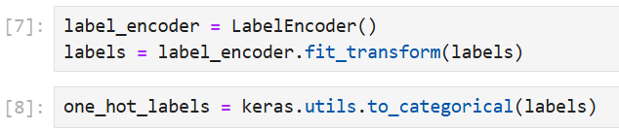
Preprocessing steps
This code converts raw text and labels into numerical formats required for model training. It tokenizes text into integer sequences using Tokenizer, pads them to uniform length with pad_sequences, encodes string labels into integers with LabelEncoder, and converts these to one-hot vectors using to_categorical. This ensures consistent input shape and categorical label format for a neural network.

Slide 9
Modeling
Model Choice
A Long Short-Term Memory (LSTM) neural network was selected due to its ability to capture temporal dependencies in sequences of words, making it ideal for understanding context in sentences.
Embedding Layer
Text input was converted into dense vector representations (word embeddings), allowing the model to understand semantic relationships between words.
Training Process
The LSTM model was trained on the preprocessed dataset. The training process involved tuning parameters using the validation set to improve generalization and prevent overfitting.

Slide 10

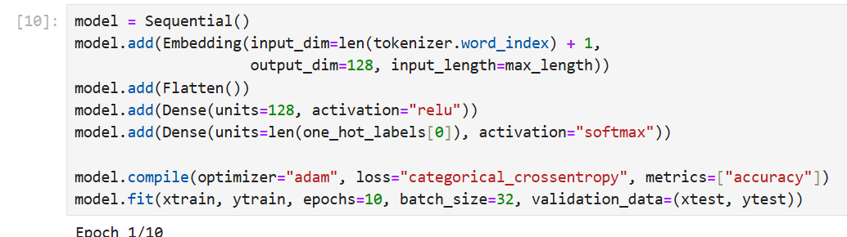
Modeling
Start of modeling
Model Architecture and Training

Slide 11
Evaluation
Model Accuracy
The model achieved high accuracy, especially for well-represented classes like joy and sadness. However, it showed slightly lower performance on less frequent classes like surprise.
Confusion Matrix
A confusion matrix was used to analyze misclassifications. Most confusion occurred between semantically close emotions such as fear and sadness

Slide 12
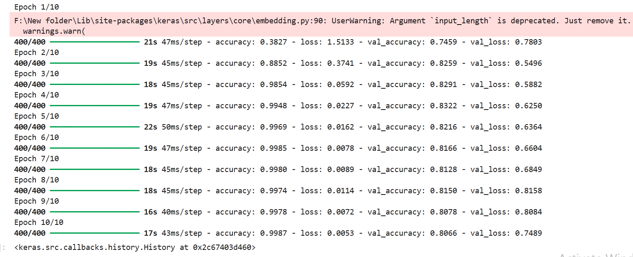
Evaluation
To assess the model’s accuracy and reliability, several metrics were used:
1.Accuracy 2.Precision 3. Recall 4. F1-Score

Slide 13
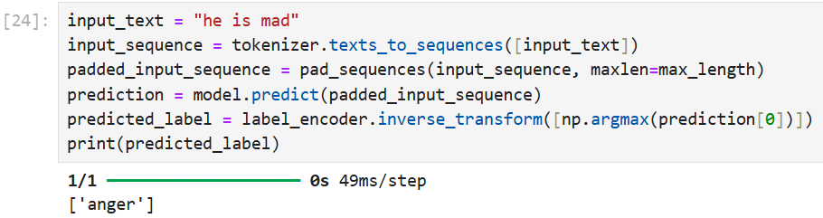
Key Findings
The model accurately classified common emotions like joy and sadness, with strong performance aided by proper preprocessing. Misclassifications occurred mainly between similar emotions such as fear and sadness. Overall, results were promising, but could improve with balanced data and a more advanced model
The key finding is to find the emotions on the basis of text which is initiated by the given output.

Slide 14
Conclusion
This project focused on classifying emotions from short English texts using deep learning techniques. The dataset consisted of labeled sentences categorized into six emotions: joy, sadness, anger, fear, love, and surprise. To prepare the data for modeling, several preprocessing steps were applied, including text cleaning, tokenization, sequence padding, and label encoding. A neural network model was then built using an embedding layer followed by dense layers, and trained on the processed data. The model achieved high accuracy, particularly on frequently occurring emotions like joy and sadness. While the overall performance was strong, the results also revealed some challenges with less represented emotions. Future improvements could include using more balanced data and implementing advanced models such as LSTM or transformer-based architectures to enhance emotional understanding and context handling.

